Slide 1
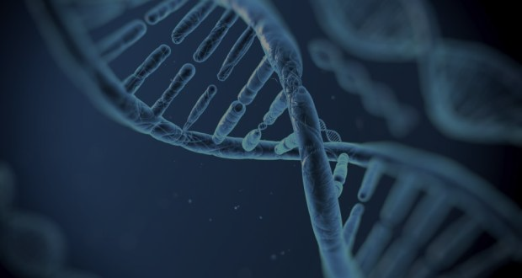
Ethics of the use of genetic data
Nishant, Nicholas, David, Tiffany
16 November 2017
Notes:
Nishant

Slide 2


Terminology
Terms
DNA - “code” that defines humans
Genome - the genetic material of an organism
Genomics - the branch of molecular biology concerned with the structure, function, evolution, and mapping of genomes.
Institutional Review Boards (IRB) - a committee tasked to evaluating the ethical ramifications of research
Notes:
Nishant
Terms: DNA - defines a human: what makes us “us”,
genome - the genetic material of an organism (human genome describes the genetic material of humans)
Genomics - the study of genomes, computationally at scale
IRBs - the “ethical gatekeepers” of research. Evaluate ethical cost/benefit, have some background in ethics

Slide 3
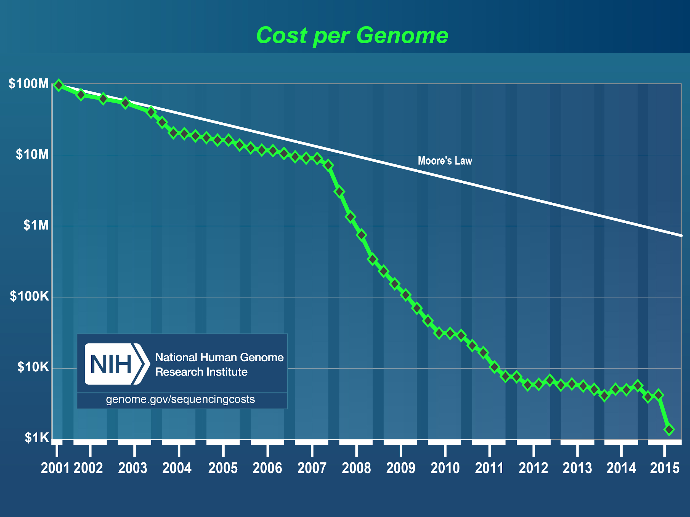
Introduction & Context
The human genome project started in 1990 and finished 13 years later
Mapped every base pair of nucleotides in the human genome
Genomics becoming priority area of research within medicine
Costs falling
Increasing computational capability
Reduced costs + commercialization leads to mass collection of DNA data
Notes:
Nishant
Genomics as a field starts with the Human Genome Project (HGP)
13 year effort to map every nucleotide pair in the human genome
Our genome has 23 chromosomes containing 6 billion base pairs, of which some actually translates, some doesn’t
Priority area due to high potential, increasing viability
Public “slippery slope” concerns

Slide 4

Million Dollar Question
What are the ethical ramifications of giving DNA data to private sector entities?
Notes:
Nishant

Slide 5

Pros:
PRO Arguments
Furthering genomic research
Personalized medicine
Enhanced longevity and quality of life
Notes:
Nicholas
Furthering Genomic Research
All of the advances we have in genomic research are due to the fact that there is genomic data available to researchers. Large databases of genomic data will allow researchers to rapidly advance our understanding of the genome and find new and innovative ways to turn those insights into tangible benefits. By creating large unified repositories of data we can ensure that data is always available to researchers in a convenient form. This is far more desirable than having many small segregated databases of genomic data.
Personalized medicine
Currently medical treatment tends to be a one size fits all approach. Where a doctor’s recommended course of action is more or less the same for every individual. This approach may work for general populations, but for many individuals it falls short.
Personalized or genomic medicine on the other hand is an approach that seeks to determine the best practical course of action for each specific individual based on their genome. This tailored approach will benefit doctors by allowing them to effectively treat more patients, by lessening time wasted on unsuccessful treatments.
Enhancing longevity and quality of life
In a world of open genomic data at risk individuals may be identified and treated prior to the development of any symptoms. Additionally thanks to pharmacogenomics doctors will have a better idea of how individuals will respond to specific drug treatments. This will save patients time and money and enhance the likelihood of successfully returning to full health.

Slide 6

CON Unscrupulous Capitalism
Buying and selling genetic information of consumers with limited or no prior knowledge
Further commodification of health-related services
Denial of insurance coverage
Notes:
Speaker David:
Most consumers don’t read the fine print and so don’t know when their genetic information is being licensed, bought or sold by private companies after they’ve swabbed.
For example, Ancestry.com ultimately has ownership of their customers DNA forever allowing them royalty-free and perpetual license to use individual’s DNA.
Supplemental health services leverage genetic data for tailored services that are unproven and expensive. Additionally more boutique services like prenatal gene selection pose ethical questions.
There are some protections in place for consumers—the Health Insurance Portability and Accountability Act of 1996 (HIPAA) and the Genetic Information Non-Discrimination Act of 2008 (GINA).
However, no federal laws regulate the use of genetic information, genetic testing, and genetic discrimination for life insurance, disability insurance, long-term care insurers, military, and law enforcement.

Slide 7

CON Unsubstantiated Legal Uses
Behavioral genetics
Genetic inheritance
Notes:
Speaker: David
Private companies have already begun sharing data in legal investigations and processes without substantial evidence for the accuracy of conclusions drawn from genetic data.
Investigators in homicides used crime scene DNA and Ancestry.com’s genetic data to find “familial links” to widen their suspect pools.
Court cases have seen the use of behavioral genetics to argue that an individual’s genes "made them do it".
Individuals with genetic predispositions have had them used to argue rulings against them in instances of custody battles and competency hearings.
Finally, the incorporation of genetic data into more and more of our legal, economic and social processes runs the risk of giving rise to “genetic classes” like in the film Gattaca. The value placed on genetic makeup is very much a foundational aspect of Eugenics. If we aren’t careful widespread use of genetic data.

Slide 8
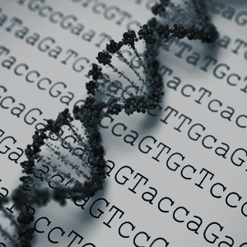

Confirmation Bias
Assuming genetic tests are accurate
Blaming a gene variant as the cause of the disease if it was present in a handful of patients
Bandwagon Bias
Notes:
Tiffany
Bandwagon bias We have a predisposition as a society to assume that genetic reports are accurate like a pregnancy test (you’re either pregnant or you’re not) when in fact genetic tests are more like a weather report. They are unpredictable because most of our gene variations are extremely rare, and by the very nature of rarity, there is not enough data to make a conclusive report.
Confirmation bias In addition, scientists fall prey to confirmation bias. If they saw a handful of patients with the disease carrying a gene variant, they classify this gene variant as pathogenic when in fact many healthy people carry it. What’s more unsettling is that other scientists rely on published papers that have this confirmation bias to inform their patients whether or not they carry the genetic disease.
For this reason, you should always have access to your genome sequenced when getting tested.

Slide 9

Likely to win argument?
Genetic testing companies
No liability Own forever, does not have responsibility once passed to third party
No class action lawsuit Customers cannot join together to file a lawsuit
Forced arbitration even after account is canceled
Loopholes in GINA Genetic Information Non-Discrimination Act 2008 Under Bill HR1313, employers can request genetic testing under the guise of a wellness program
Notes:
Tiffany
Now that we know the pros and cons, who do we think is likely to win the argument? It is not so much about the argument itself but the regulations that are already in place to give one side the unfair advantage. Currently, genetic testing companies have this advantage. When consumers signed the terms of agreement, they agree to hand over their ownership to their DNA sequence forever. Once given, genetic testing companies are not held liable to any repercussion. If customers are unhappy with how their genetic information is being used, they cannot bring it up to the court of law and are forced to resolve their disputes via arbitration. They are also not allowed to file lawsuit with other disgruntled customers.
What’s more, even though GINA contains protections to prohibit health insurers and employers from using your genetic information against you, it contains loopholes which allows employers to request you to undergo genetic testing under the guise of a wellness program. Bill HR1313, introduced March of this year, exploits this loophole.
As much as we would like to say that there are more pros than cons, we must ensure that regulations maintain privacy protection to address the cons that we are facing today.

Slide 10

A suitable middle ground
Significant benefits to collection and maintenance of genome datasets
Regulate allowable actions with these datasets
Democratize the creation of these allowed uses to IRBs world-wide
Emphasis on transparency and academic debate
Stakeholders: academics, governments, consumers
Notes:
Nishant
Deaf sense of “Community” - not perceived as a problem: https://www.theatlantic.com/health/archive/2013/08/understanding-deafness-not-everyone-wants-to-be-fixed/278527/
List of IRBs in department of energy: https://science.energy.gov/ber/human-subjects/irbs/

Slide 11
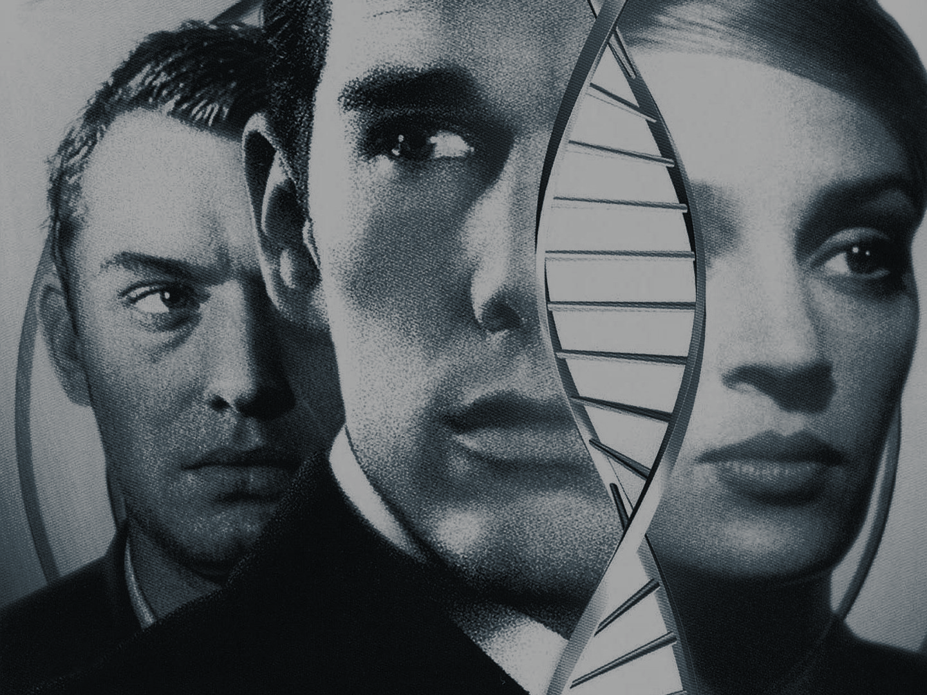

Q U E S T I O N S
Nishant - nishray@berkeley.edu
Nicholas - nconidas@berkeley.edu
David - david.lindsey@berkeley.edu
Tiffany - tiffanyjaya@berkeley.edu
Notes:
Speaker FirstName
Speaker Script or Notes

Slide 12
Bibliography
Winston, Joel. “Ancestry.com Takes DNA Ownership Rights from Customers and Their Relatives.” Think Progress, Think Progress, 17 May 2017, thinkprogress.org/ancestry-com-takes-dna-ownership-rights-from-customers-and-their-relatives-dbafeed02b9e/.
Brown, Kristen V. “What DNA Testing Companies' Terrifying Privacy Policies Actually Mean.” Gizmodo, Gizmodo.com, 18 Oct. 2017, gizmodo.com/what-dna-testing-companies-terrifying-privacy-policies-1819158337.
Brown, Kristen V. “Why We Should All Be Worried About Congress Eroding Protections Against Genetic Discrimination.” Gizmodo, Gizmodo.com, 16 Mar. 2017, gizmodo.com/why-we-should-all-be-worried-about-congress-eroding-pro-1793271532.
Yong, Ed. “Clinical Genetics Has a Big Problem That's Affecting People's Lives.” The Atlantic, Atlantic Media Company, 16 Dec. 2015, www.theatlantic.com/science/archive/2015/12/why-human-genetics-research-is-full-of-costly-mistakes/420693/.
Arnold, Carrie. “The Uncertain Future of Genetic Testing.” The Atlantic, Atlantic Media Company, 19 July 2017, www.theatlantic.com/science/archive/2017/07/the-uncertain-future-of-genetic-testing/534045/.
Zhang, Sarah. “A Decade Later, a Patient Finds Out Her Genetic Test Was Wrong.” The Atlantic, Atlantic Media Company, 11 May 2017, www.theatlantic.com/health/archive/2017/05/when-your-genetic-test-is-wrong/525126/.
Lennon, Greg. “Own Your DNA.” MIT Technology Review, MIT Technology Review, 23 Feb. 2016, www.technologyreview.com/s/600845/own-your-dna/.

Slide 13

Existing uses of genomic data
1
BRCA-1 gene predisposition to breast cancer
Identify subtypes of cancer
2
3
At-birth screening for inherited but treatable genetic disorders
Pharmacogenetics use genome to see if drug will be effective
4
5
CRISPR technology to target DNA sequences
Notes:
Nishant
https://www.genome.gov/27552451/what-is-genomic-medicine/
https://www.yourgenome.org/facts/what-is-crispr-cas9
BRCA 1 - gene strongly correlated with breast cancer development
Her2+ gene subtypes
At birth screening for: phenylketonuria (PKU), cystic fibrosis, sickle cell disease, critical congenital heart disease, hearing loss
https://ghr.nlm.nih.gov/primer/newbornscreening/nbsdisorders

Slide 14
Pros:
PRO Arguments
“Accelerated evolution” i.e. Google’s Calico search to lengthen human life span
Reduction in genetic disease phenotypes i.e. Parkinson’s disease
Personalized approaches to medicine
Repository of large genetic data in USA
Booming market $70 million in 2015 -> $340 million by 2022
Notes:
Nicholas
Personalized medicine
Currently medical treatment tends to be a one size fits all approach. Where a doctor’s recommended course of action is more or less the same for every individual. This approach may work for general populations, but for many individuals it falls short.
Personalized or genomic medicine on the other hand is an approach that seeks to determine the best practical course of action for each specific individual based on their genome. This tailored approach will benefit doctors by allowing them to effectively treat more patients, by lessening time wasted on unsuccessful treatments.
Furthering Genomic Research
All of the advances we have in genomic research are due to the fact that there is genomic data available to researchers. Large databases of genomic data will allow researchers to rapidly advance our understanding of the genome and find new and innovative ways to turn those insights into tangible benefits. By creating large unified repositories of data we can ensure that data is always available to researchers in a convenient form. This is far more desirable than having many small segregated databases of genomic data.
Enhancing longevity and quality of life
In a world of open genomic data at risk individuals may be identified and treated prior to the development of any symptoms. Additionally thanks to pharmacogenomics doctors will have a better idea of how the individuals will react to specific drug treatments. This will save patients time and money and enhance the likelihood of successfully returning to full health.

